Slide 1
Databases III databae programming physical schema query optimization
Gilles Falquet
Centre universitaire d'informatique
UniGE

Slide 2
Programming and Databases
SQL and the relational algebra query are not Turing complete
=> Database Application must rely on general purpose languages
Difference solutions
procedural extensions of SQL (PL/SQL, etc.)
SQL-like extensions of general purpose languages (SQLJ, ...)
libraries to invoke database services from a general purpose languages (JDBC)
through an interface (web) service

Slide 3
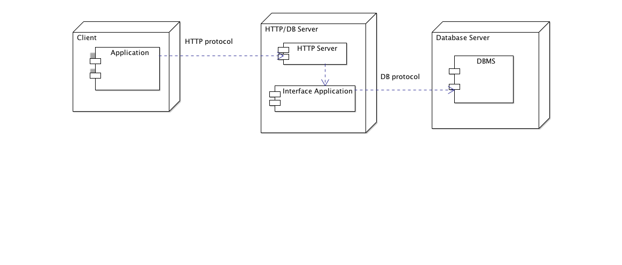
Invoking database interface service
send queries to an HTTP (web) server to invokes the interface application
get result as HTTP content (text, HTML, XML, JSON)
transform results to application language objects (Scala, C, R, ...)

Slide 4
Example: a basic protocol
HTTP request: send an SQL statement
http://kr.unige.ch/phpmyadmin/query.php?db=Enviro&sql=select%20name,subregion%20FROM%20country
Returned content
Afghanistan\tSouth Asia\nAlbania\tCentral Europe\nAlgeria\tNorthern Africa\nAmerican Samoa\tSouth Pacific\nAndorra\tWestern Europe\nAngola Southern Africa\nAnguilla\tCaribbean\nAntarctic\tAntarctic\nAntigua and Barbuda\tCaribbean\nArgentina\tSouth America\nArmenia\tEastern Europe\nAruba\tCaribbean\nAustralia\tAustralia + New Zealand\nAustria\tWestern Europe\n ...

Slide 5
Example: send a query to an http server
import java.net._
def countriesInSubRegion(sr: String): Set[String] = {
val q = "select name from country where subregion = '" + sr + "'"
val eq = URLEncoder.encode(q, "UTF-8")
val u = new java.net.URL(
"http://kr.unige.ch/phpmyadmin/query.php?db=Enviro"+"&sql="+eq)
val in = scala.io.Source.fromURL(u, "iso-8859-1")
var res = Set[String]()
for (line <- in.getLines) {
val cols = line.split("\t")
res += cols(0)
}
in.close()
res
}

Slide 6
Problem 1: Model Mismatch
necessary to convert between the application data structure and the database schema
a graph in a relational DB
create table EDGE(fromNode INTEGER, toNode INTEGER, weight REAL)
in a Scala program
var adjacentNodes = Map[Node, Set[Node]]
var weights = Map[(Node, Node), Double]

Slide 7
Problem 2: A language within a language
The application must build SQL statements
=> concatenate SQL strings and application variables
sql = "select name from country where pop > " + max.toString
+ " and subregion = " + sr
the syntax of these SQL statements is not checked by the host language compiler
=> possible run-time errors

Slide 8
Problem 3: Algorithmic Design
the dbms efficiently computes selections/projections/joins (SQL statements)
(if the appropriate indexes have been set up)
=> avoid re-inventing these operations in the application
transferring data between servers is much less efficient than in-memory transfers
=> reduce the number of database queries
=> favor "powerful" select statements
act on many data items and produce small outputs

Slide 9
Logical independence
concept introduced with the relational data model
the user/developer sees the database as a set of tables
the actual storage technique is hidden
similar to the abstract datatype technique in object-oriented programming

Slide 10
what we see
how it is stored
on disk/ssd/ram

Slide 11
Interest
query expression is independent of the storage technique
a database may be moved to a completely different DBMS without changing the queries (if they are written in standard SQL)
the storage technique can be changed without affecting the SQL queries
a better (optimized) storage technique immediately improves the performance of all the queries
database managers may optimize the storage (size & execution time) independently of all the users and developers

Slide 12
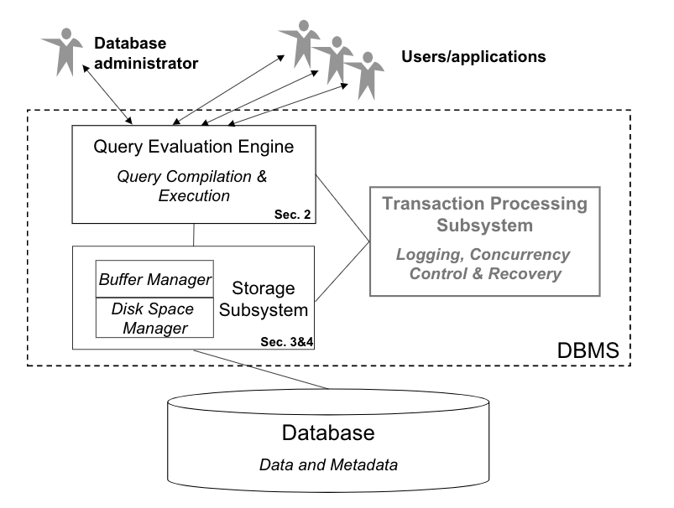
DBMS Architecture
https://www.cise.ufl.edu/~mschneid/Research/papers/HS05BoCh.pdf

Slide 13
Storage media
Hard disks, SSD memory
permanent storage
made of blocks (thousands of bits)
access granularity: read/write an entire block
RAM memory
volatile storage (needs permanent electric power)
access: very small blocks (8, 16, 32, 64 bits)

Slide 14
Placing data items on disk
attribute values → one or several bytes → fields
tuples → several fields → records
Records need to be stored in physical blocks
A collection of records that forms a relation is stored as a collection of blocks → file

Slide 15
Heap file representation of a relation
one record for each tuple
records stored in arbitrary order
variable length records
=> records must have a header to specify the field lengths

Slide 16
vid | category | owner
89494 | bicyle | 145
GE78344 | car | 204
33733 | bicycle | 755
3343433 | scooter | 204
h
89494
"bicycle"
145
h
GE78344
"car"
204
Vehicle relation
block 1
block 2
Vehicle file (records in arbitrary order)

Slide 17
Relational operations with a heap file organization
Selection: σ_{Condition}r
Algorithm
for each block b in r file
for each record d in b
extract the fields involved in Condition
evaluation Condition on these fields
if true add the record to the result
Time complexity: O(no. of blocks to read) = O( |r| ) (size of r (in tuples))

Slide 18
Join r ⋈_{X=Y} s
Algorithm
for each record d in r file
for each record e in s file
x = field X of d ; y = field Y of e
if x == y add d . e to the result
Complexity: O( |r| × |s| )

Slide 19
Optimization by re-ordering
Execution of a SQL query
transform to algebraic expression
optimize the expression
execute the expression of the relation store

Slide 20
σ_{S.D} _{< S.E}
select *
from R, S
where R.X = S.Y and R.A = 23 and S.D < S.E
==> σ_{S.D} _{< S.E}(σ_{R.A = 23} (R ⋈_{X=Y} S)))
σ_{R.A = 23}
R ⋈_{X=Y} S
R
S

Slide 21
Move the selection downward
R ⋈_{X=Y} S
select *
from R, S
where R.X = S.Y and R.A = 23 and S.D < S.E
==> σ_{S.D} _{< S.E}(σ_{R.A = 23} (R ⋈_{X=Y} S)))
==> (σ_{R.A = 23} R) ⋈_{X=Y} (σ_{S.D} _{< S.E}S)
σ_{R.A = 23}
σ_{S.D} _{< S.E}
R
S

Slide 22
Performance Improvement
If the size of σ_{Cond}r is α |r|
Time(σ_{Cond}(r ⋈_{X=Y} s)) (T)
= κ₂ (|r| × |s|) + κ₁ |r ⋈_{X=Y} s|
Time((σ_{Cond}r) ⋈_{X=Y} s) (T_{optimized})
= κ₁ |r| + κ₂ (α|r| × |s|)
If κ₁ = κ₂ T_{optimized}/T < α + 1/|s|

Slide 23
Adding indexes
Reordering the operations is not enough, not always applicable
Index: a structure to efficiently find (O(1) or O(log n) time)
the records that have a value v in field A
the records that have a value between v1 and v2 in field A
the records that have values (v1, v2, ..., vk) in fields A1, A2, ..., Ak
== implementation of a map [Domain(A) -> Set[Record]]
create index idx on table (list of columns)

Slide 24
Example: Ordered index on a primary key field
V file
index file
on vid
 | 33CZ733
 | A343433
 | B89494
 | GE78344
vid | category | owner
B89494 | bicyle | 145
GE78344 | car | 204
33CZ733 | bicycle | 755
A343433 | scooter | 204
V table
Binary search in the index file
=> access in O(log n)

Slide 25
Other index types
Hashtables
B⁺trees
If the indexed attribute is not a key
each attribute value is associated to a set of records

Slide 26
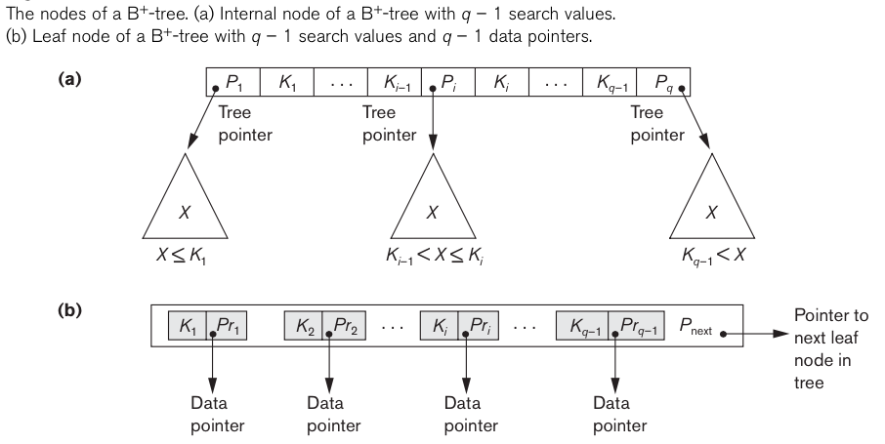
(Elmasri &Navathe, 2011)

Slide 27
Acceleration of the selections
for σ_{Condition}r
if Condition is of the form A = v and there is an index on attribute A
lookup v in the index
read the records pointed at in v's entry
Time(select) = O(no. of records with A = v)

Slide 28
Join acceleration
for r ⋈_{X=Y} s
for each record u in r file
lookup u.X in the index on Y of s
for each record v of s associated with the value u.X
add u . v to the result
Time complexity
O(|r| × (lookup time in index + average no. of joined tuples in s))

Slide 29
Cost associated with indexes
After each relation update (insert/delete/update)
update all the indexes of this relation
Size of the indexes
each index has approx. the size of the column(s) it indexes

